Slide 1
Assistive, accessible technologies of the future
Wantanee Phantachat
National Electronics and Computer Technology Center
National Science and Technology Development Agency
Ministry of Science and Technology
Thailand

Slide 2
ICT Accessibility Benchmark
“One of the most critical areas of ICT accessibility with the greatest impact on the largest number of persons with disabilities, the accessibility of the information infrastructure of ratifying countries, is lagging behind general commitments in support of the rights of persons with disabilities.”
Figure 3: Graph showing the degree of implementation for specific ICT technologies, products and services
Source: Convention on the Rights of Persons with Disabilities 2012 ICT Accessibility Progress Report

Slide 3
States Parties Level of CRPD ICT Accessibility
Compliance by Region
States Parties Level of CRPD ICT Accessibility Compliance by Region | Africa | Americas | Asia-Pacific | Europe
3 - Assessment of the Country’s Implementation and Impact
3.1 Telecom and Media Services
Programs to facilitate the Usage of Telephony by PwDs | 0% | 33% | 29% | 53%
Wireless Telephone Handset with Accessibility Features | 25% | 50% | 75% | 38%
Closed Captioning/Sign Language Interpretation by TV Broadcasters | 38% | 67% | 69% | 67%
Sign language for news, emergency communications/ live announcements | 31% | 67% | 54% | 47%
Captioning of Live Programs | 15% | 50% | 17% | 47%
Captioning of pre-recorded programs or movies | 8% | 17% | 17% | 53%
Video or Audio Description for the Blind | 0% | 17% | 8% | 47%
Accessible Government Web Sites | 15% | 83% | 43% | 80%
Accessible Web Sites among the top 10 Commercial and Media Ones | 0% | 17% | 33% | 42%
3.2 Computers
PC Operating System Most Used in the Country Official Language That Supports Text to Speech and Voice Recognition Capabilities | 31% | 50% | 57% | 73%
Screen Readers Available in the Main Language | 42% | 83% | 57% | 80%
Screen Reader in Minority Language of the Country | 15% | 17% | 17% | 25%
Alternative Input Devices Available | 23% | 80% | 71% | 87%
3.3 Specific ICT Products and Services
Library for the Blind or providing e-books Services | 54% | 100% | 86% | 93%
Assistive Technology Available to PwDs at Major Universities | 31% | 83% | 54% | 64%
Accessible Public Electronic Kiosks or ATMs | 23% | 50% | 36% | 50%
Source: Convention on the Rights of Persons with Disabilities 2012 ICT Accessibility Progress Report

Slide 4
Critical Level of CRPD ICT Accessibility in Asia Pacific Region
Video or Audio Description for the Blind 8%
Captioning of Live Programs 17%
Captioning of pre-recorded programs or movies 17%
Screen Reader in Minority Language of the Country 17%
Programs to facilitate the Usage of Telephony by PwDs 29%
Accessible Web Sites among the top 10 Commercial and Media Ones 33%
Accessible Public Electronic Kiosks or ATMs 36%
Accessible Government Web Sites 43%

Slide 5
States Parties Levels of CRPD ICT Accessibility
Compliance by Level of Human Development
Source: Convention on the Rights of Persons with Disabilities 2012 ICT Accessibility Progress Report

Slide 6
Critical Level of CRPD ICT Accessibility Compliance by Level of Human Development
Screen Reader in minority language of the country (All levels)
Captioning of pre-recorded programs or movies (All levels)
Video or Audio Description for the Blind (All levels)
Wireless Telephone Handset with Accessibility Features (3 levels)
Captioning of Live Programs (3 levels)
Programs to facilitate the Usage of Telephony by PWDs (3 levels)
Accessible Web Sites among the top 10 Commercial and Media Ones (3 levels)
Accessible Public Electronic Kiosks or ATMs (3 levels)

Slide 7
Looking for Future Technology
To support countries that show less implementation on ICT accessibility:
Speech Syntheses for Minority Languages in each countries : Open platform for development
Tools for captioning; prerecorded and live captioning media : Captioning Process
Tools for or Audio Description : Audio description Guideline
Wireless Telephone Handset with Accessibility Features : keyboard layout
Programs to facilitate the Usage of Telephony by PwDs : relay service mobile application, mobile application for the blinds
Tools for accessible website development and tools for accessibility checking
Standard Software protocal for Talking ATM

Slide 8

Best Practice in Thailand
Open Platform for Speech Syntheses Development
Msapi based
Android Based
Linux Based
Thai Speech Syntheses
Mongolian Speech Syntheses
Laos Speech Syntheses
Bhutanese Speech Syntheses

Slide 9

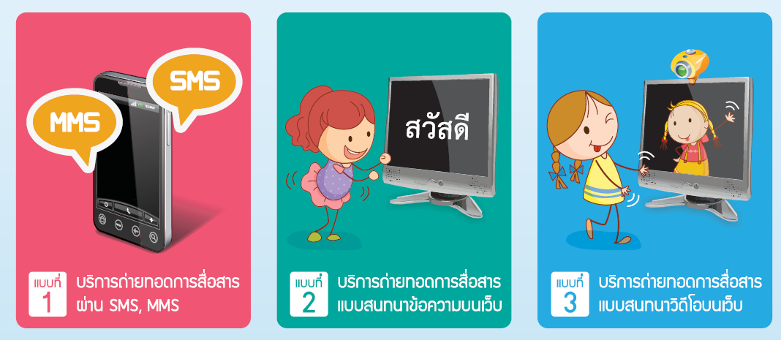
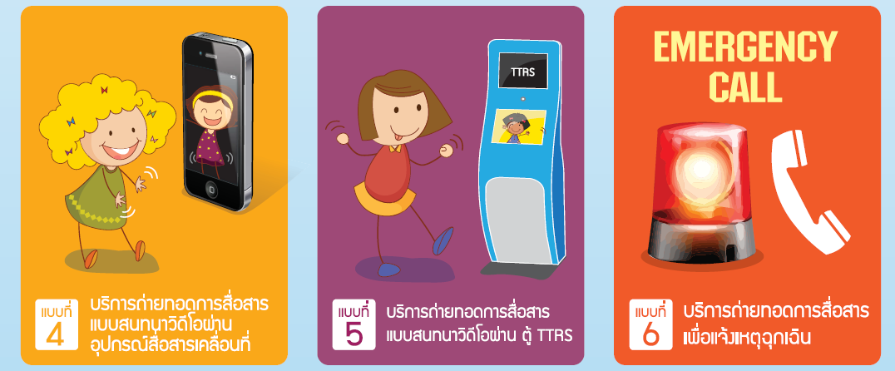
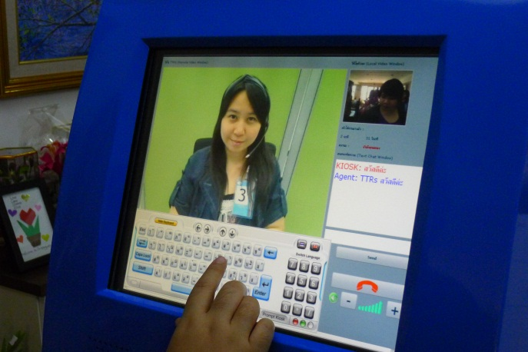
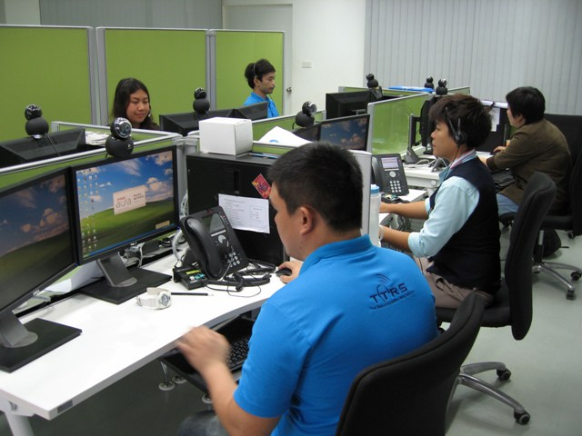
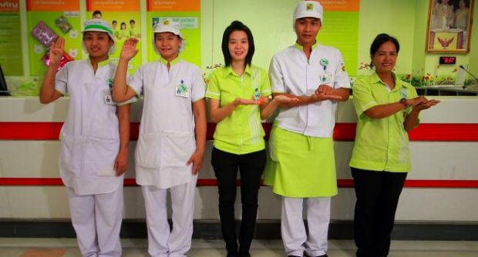


Thai Telecommunication Relay Service
6 services of TTRS

Slide 10
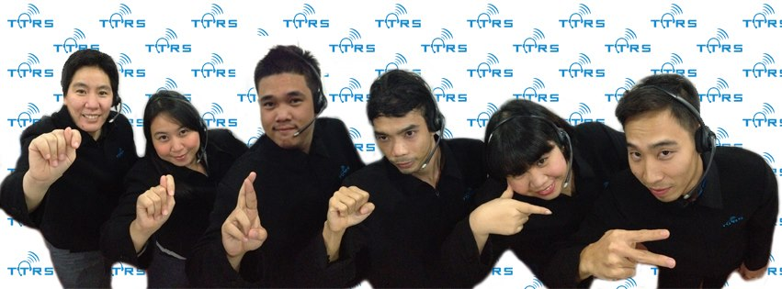
Thank you for your attention

